Slide 1
APRIL-MID MAY DATA VALIDITY SUMMARY CHASSIS NO ENGINE NO MAKE MODEL CUBIC CAPACITY CARRY CAPACITY YR_ MANFT COLOR BODY TYPE

Slide 2
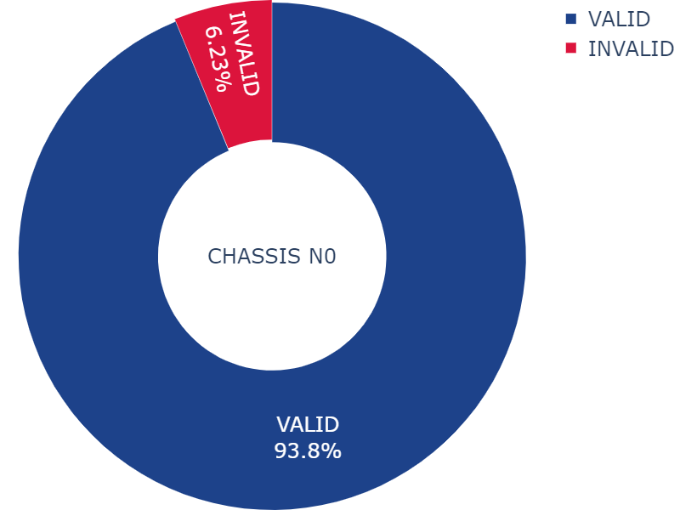
VALIDATION CRITERIA CHASSIS NO:
Should have 9-17 characters in length.
Can be either numerical, alphabetic or alphanumeric
Should not be a number plate
Should not look like guess work
Should not be blank

Slide 3
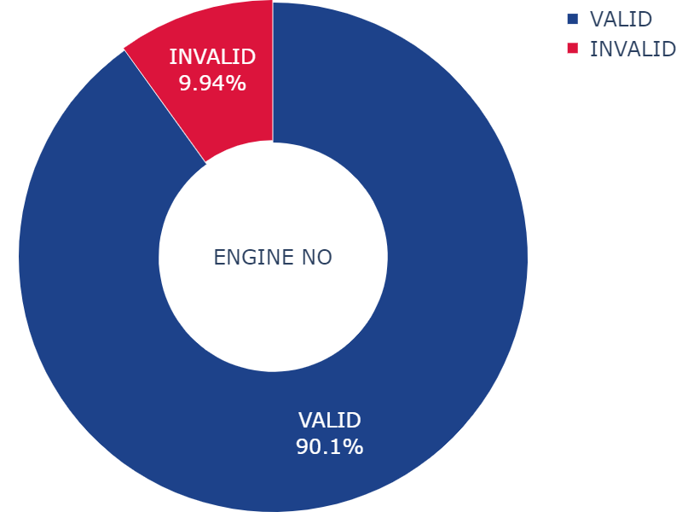
VALIDATION CRITERIA ENGINE NO:
Contain 5 characters and above
Must not be a car registration number
Must not be blank
Should not look like guess work

Slide 4
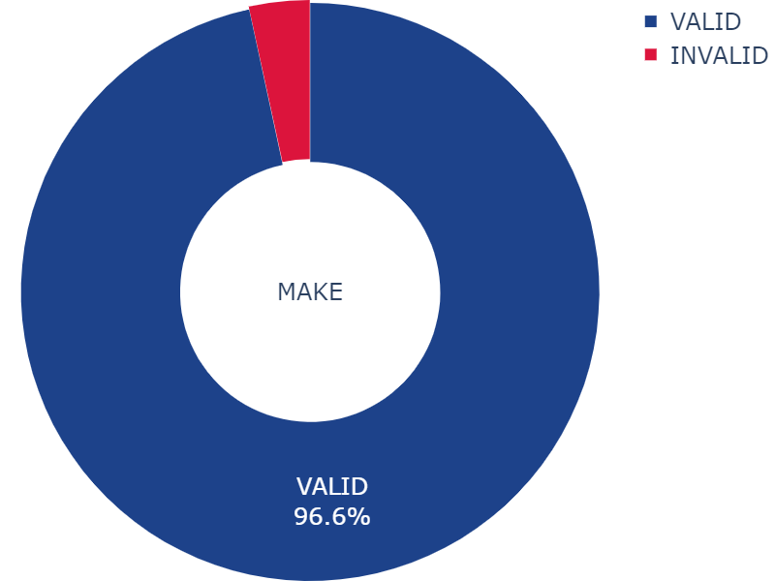
VALIDATION CRITERIA MAKE:
Should be an existing car make.
Should be well spelt
Should not be blank
Accept both upper and lower case spelling
Accept unnecessary spacing and special characters
Not be blank

Slide 5
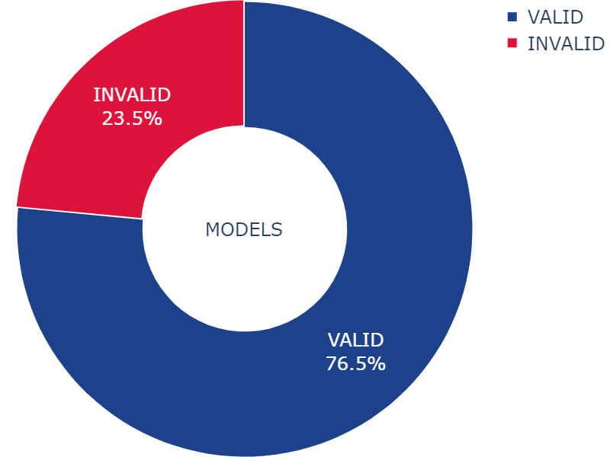
VALIDATION CRITERIA MODELS:
Must belong to an existing make validated together
Must be the exact existing model
Must be correctly spelt.
Ignore casing and spacing and validate as valid

Slide 6
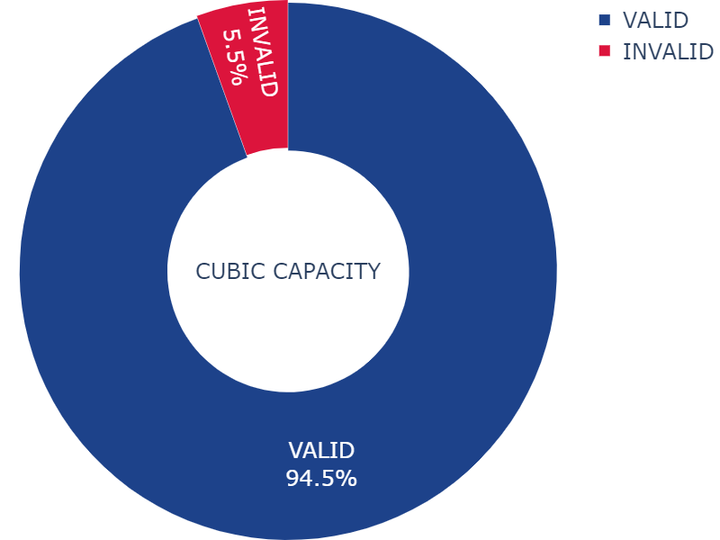
VALIDATION CRITERIA CUBIC CAPACITY:
Should be between 20 and 7000.
Should not be blank
Should be numeric

Slide 7
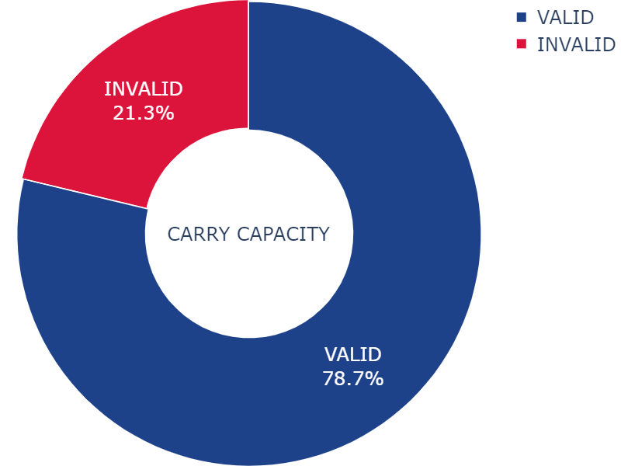
VALIDATION CRITERIA CARRY CAPACITY:
Should contain a valid carry capacity associated with the respective make and model of the vehicle being validated.
Should be numeric
Should not be blank

Slide 8

VALIDATION CRITERIA YR_MANFT:
Must be a valid year
Must be a realistic year
Must not be blank

Slide 9
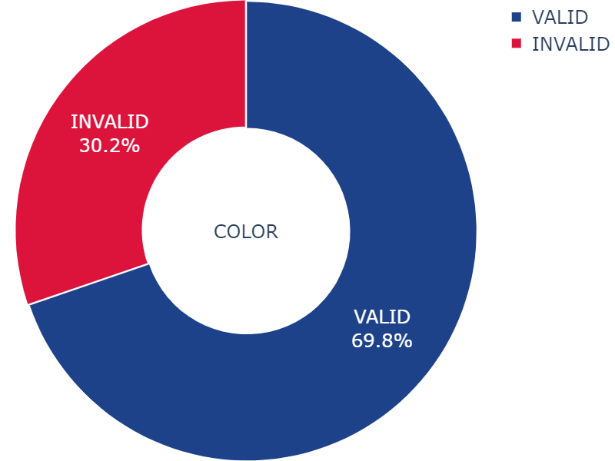
VALIDATION CRITERIA COLOR:
Must be an existing color
Must be correctly spelt
Must not be empty
Ignore casing and spacing

Slide 10
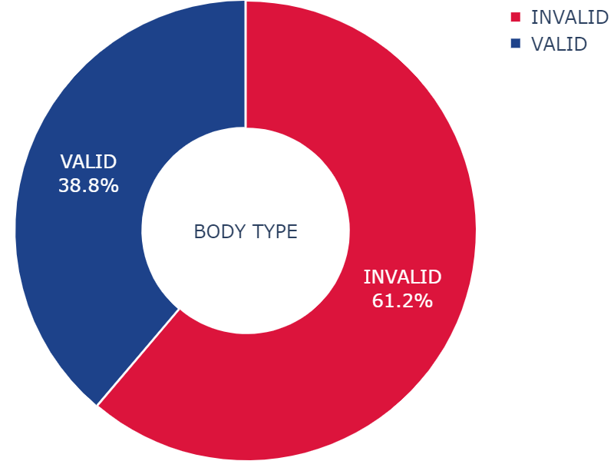
VALIDATION CRITERIA BODY TYPE:
Must be a valid body type
Must be well spelt
Must not be blank
Ignore casing and spacing

